Slide 1
.NET MAUI MVVM Architecture

Slide 2
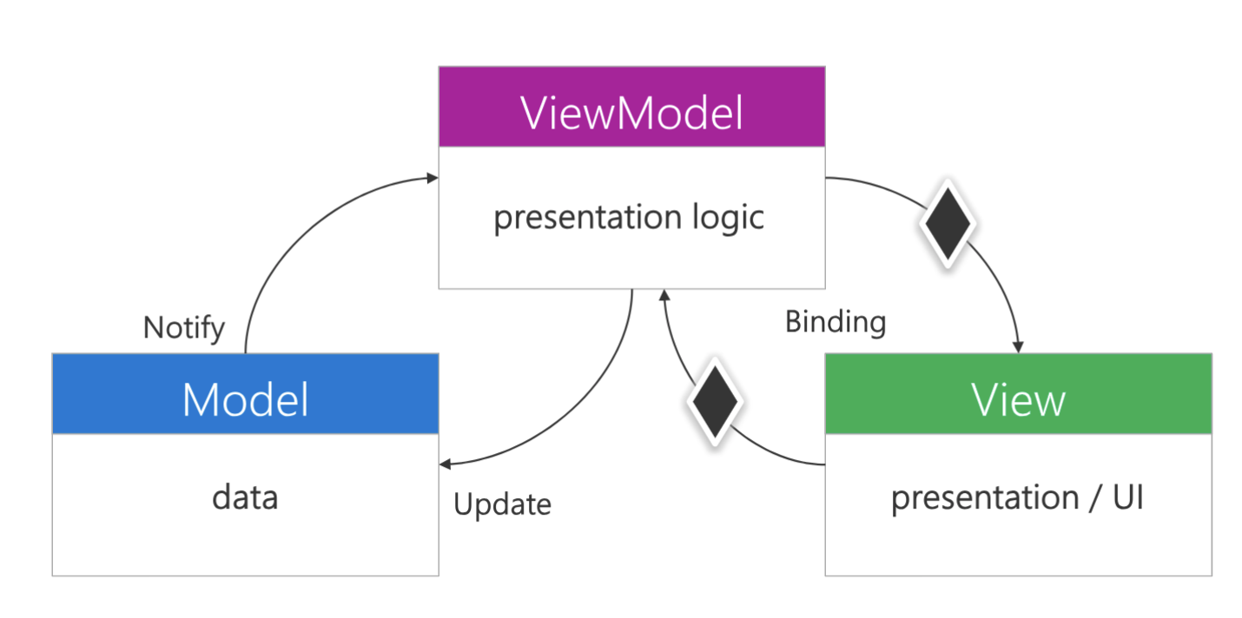
MVVM Architecture What is MVVM?
Model
Data Structure
View
User Interface
ViewModel
Business Logic
source: Xamarin University

Slide 3
MVVM Architecture What is a Binding?
INotifyPropertyChanged
“Shouts” a property name between View +ViewModel when the property value changes
Then MAUI redraws the UI using the property’s new value
source: Xamarin University

Slide 4
MVVM Architecture Why MVVM?
(tl;dr Maintenance)
Loosely Coupled Data
The View knows nothing about the ViewModel
(and vice-versa)
Separation of Concerns
Easy to replace entire UI
Easy to modify business logic (View Model)

Slide 5
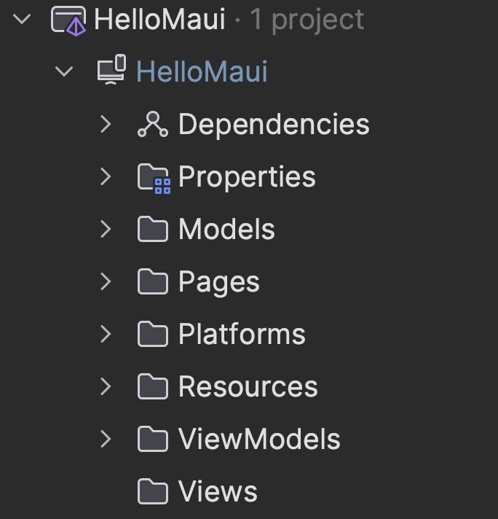
MVVM Architecture Folder Structure
Pages
ContentPage
ViewModels
Models
Views
Custom Views
E.g. PurpleButton

Slide 6
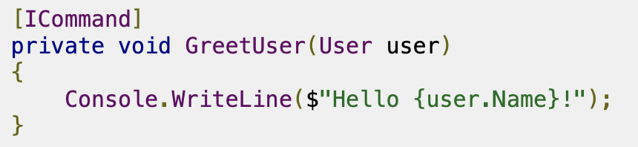

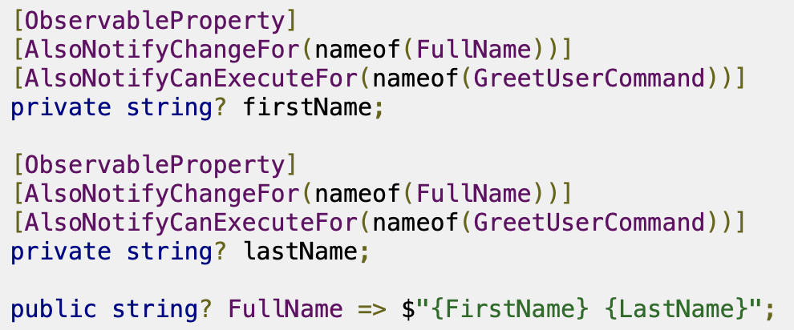
MVVM Architecture CommunityToolkit.Mvvm
Use Attributes to Simplify Code
[RelayCommand]
[ObservableProperty]
[AlsoNotifyChangeFor]
[AlsoNotifyCanExecuteFor]

Slide 7

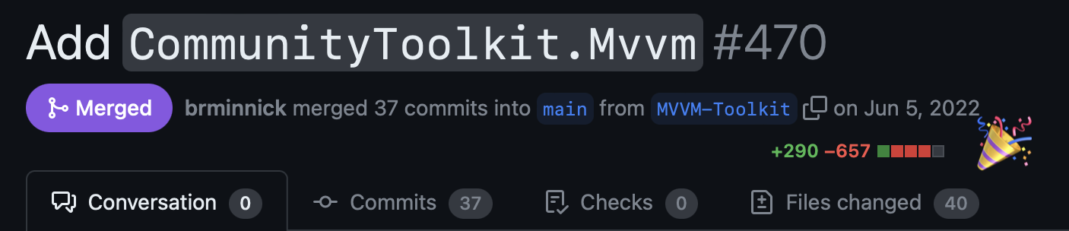
MVVM Architecture CommunityToolkit.Mvvm
Use Attributes to Simplify Code
[ICommand]
[ObservableProperty]
[AlsoNotifyChangeFor]
[AlsoNotifyCanExecuteFor]

Slide 8
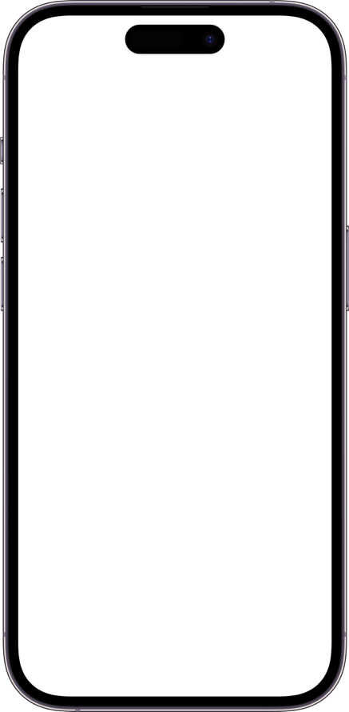
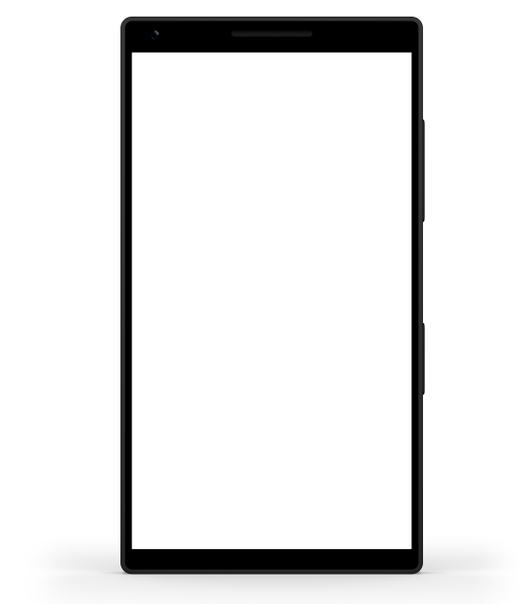
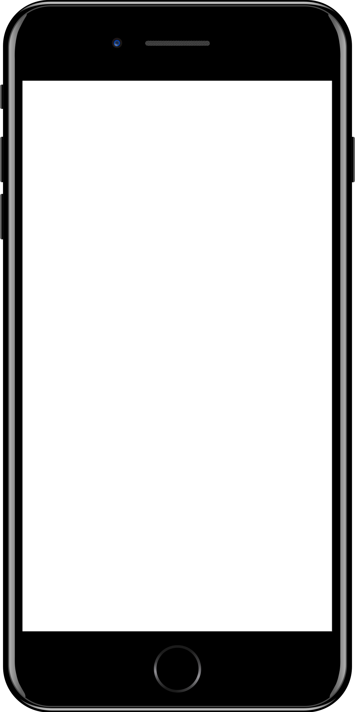
Sample mobile app slide
iPhone 7/8
iPhone 14
Generic phone
(BrandCentral)
App screenshots can be placed behind these transparent .pngs

Slide 9
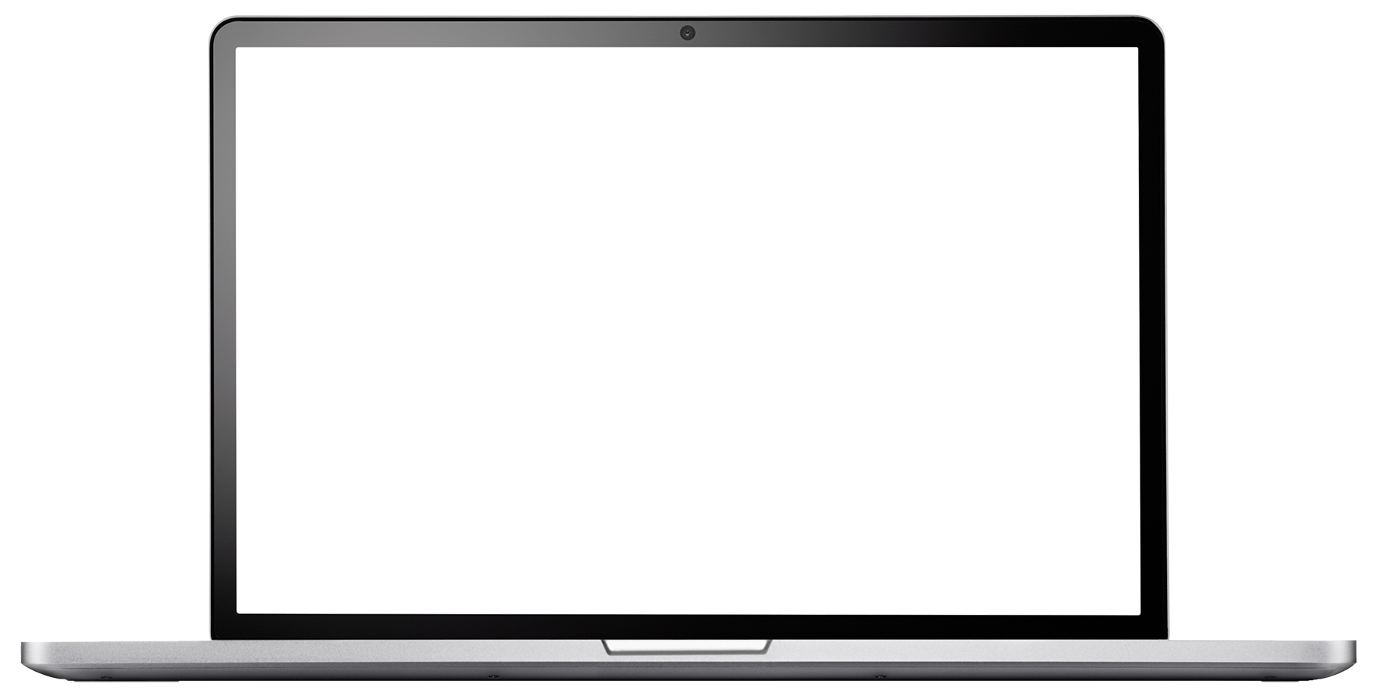
Sample website slide (blank)
Website screenshots can be placed behind this transparent .png

Slide 10
Bullet points layout with subtitle Subtitle is smaller in the same text block
Example of a bulleted slide with a subhead
Set the slide title to “Sentence case”
Set subheads to “Sentence case”
Hyperlink style
www.microsoft.com

